Slide 1
Open Science Breakout Sessions

Slide 2
Session 1: Tuesday 2:00-4:00 pm
2:00 - 2:15 ARM GitHub Organizations (Theisen)
2:15 - 2:30 Python ARM Radar Toolkit (Py-ART; Grover)
2:30 - 2:45 Atmospheric data Community Toolkit (ACT; Theisen)
2:45 -3:15 ARM JupyterHub and Data Workbench (Dumas/Grover)
3:15 - 3:30 Basics of Python (O’Brien)
3:30 - 4:00 Advanced Python - Xarray, Pandas (Kehoe)

Slide 3
Session 2: Tuesday 4:15-6:15 pm
4:15 - 5:15 Py-ART Tutorial (Grover, O’Brien, Sherman)
5:15 - 6:15 ACT Tutorial (Theisen, Grover, O’Brien, Sherman)

Slide 4
Session 3: Wednesday 2:00-4:00 pm
2:00 - 2:15 Enhancing Geoscientific Computational Skills with Project Pythia: A Pathway to Open Science. (Sharma)
2:15 - 2:30 Using PySP2 to process Single Particle Soot Photometer (SP2) Data (Jackson)
2:30 - 2:45 Earth Model Column Collaboratory EMC^2 (Jackson)
2:45 - 3:00 ARM And The U-IFLs, How CROCUS Can Inform ARM Open Instrument Science (Collis)
3:00 - 3:15 ARM Climatologies: An Experiment in Open Paper Development (Theisen)
3:15 - 3:30 ARM data-oriented metrics and diagnostics package for GCMs (ARM-Diags) (Tao)
3:30 - 3:45 Python library for color-vision deficient colormaps (Sherman)
3:45 - 4:00 Open computing at the edge with SAGE (Raut)

Slide 5
ARM GitHub Organizations

Slide 6
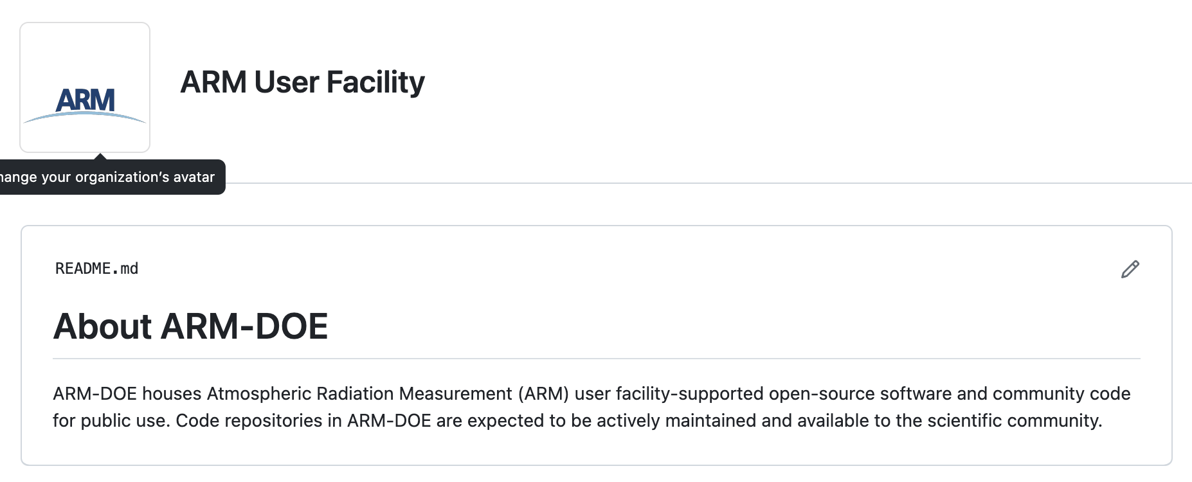
ARM-DOE: https://github.com/ARM-DOE
Purpose: Host ARM-supported open-source software and community code
Repositories Include:
Python-ARM Radar Toolkit (Py-ART)
Atmospheric data Community Toolkit (ACT)
PySP2
ADI

Slide 7
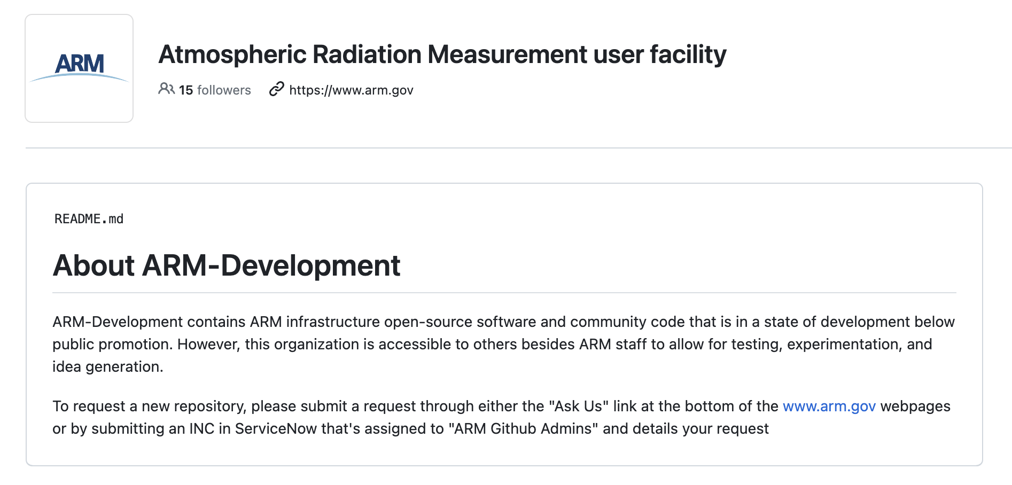
ARM-Development: https://github.com/ARM-development
Purpose: Hosts development projects from ARM infrastructure
Repositories include:
ARM-Notebooks
comble-mip
RadTraQ

Slide 8
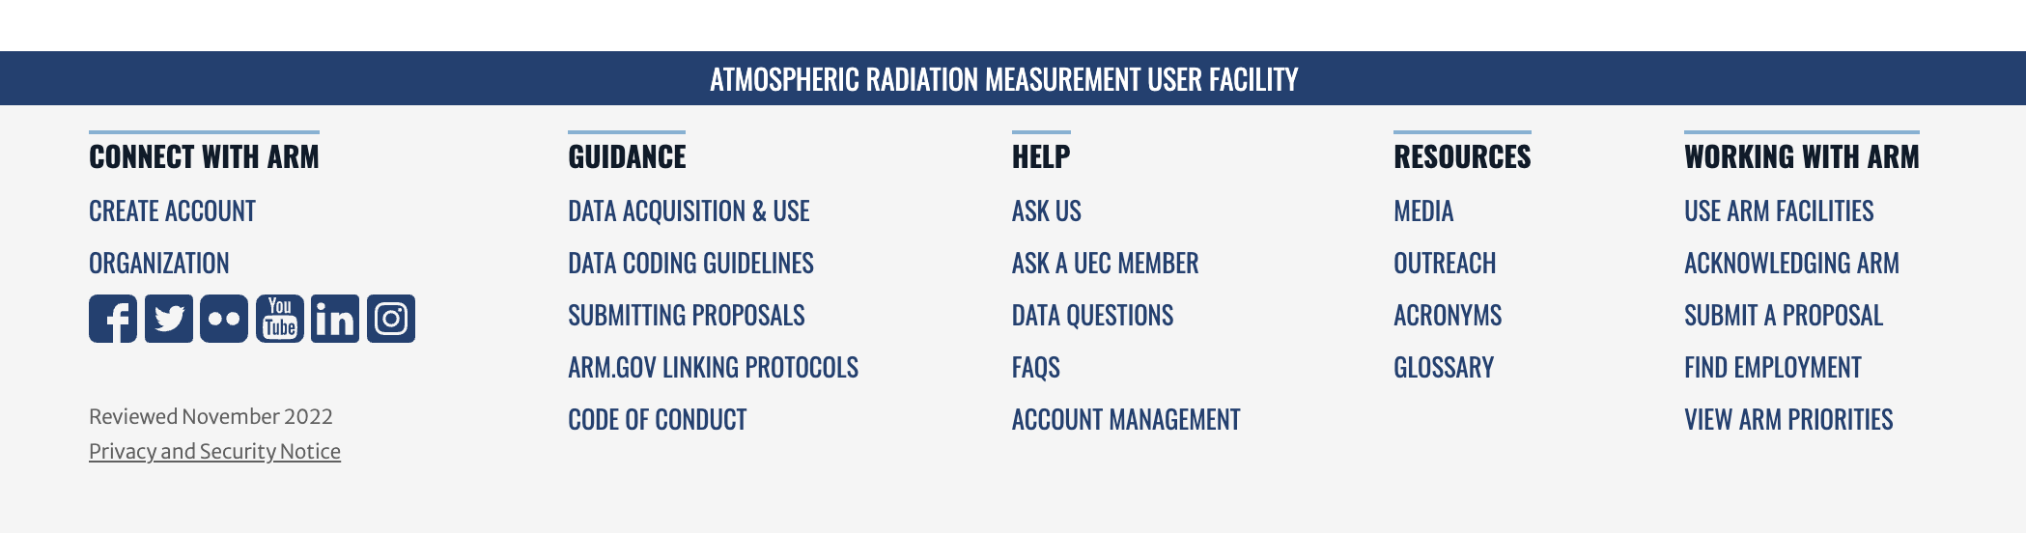
ARM-Synergy: https://github.com/ARM-Synergy
Purpose: Host ARM/ASR PI open-source software and community code
Repositories include:
simpleSOM_boxmodel
tracer-plotting
How to request a repository:
Use the “ASK US” link in the footer on any ARM webpage!

Slide 9

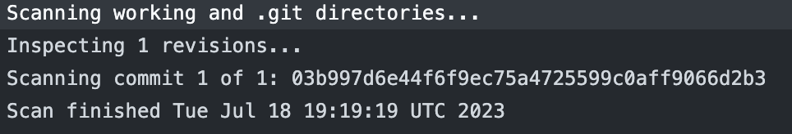
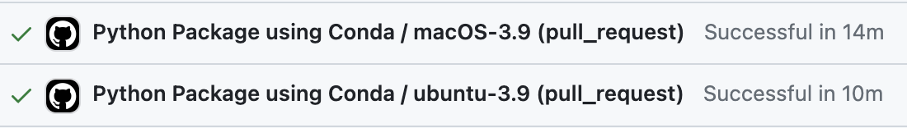
Requirements
ARM Staff Provides
Vulnerability Scanning
Anti-virus scanning
Security team with read capabilities
PI Provides
Code!
Descriptive readme files that provide an overview of the code and how it can be used
GitHub Provides
A great platform for sharing code!
DOIs through Zenodo
Actions for unit tests and more!

Slide 10
Survey!
Show of hands, who would be interested in hosting their code on ARM-Synergy?

Slide 11
Survey!
Would there be interest in having organization level discussion pages?

Slide 12
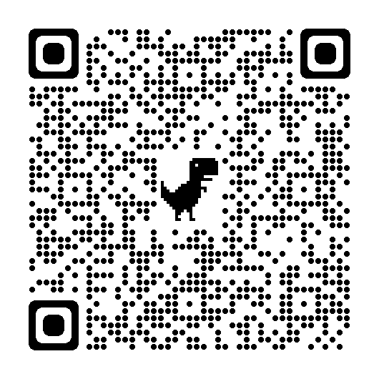
Survey!
Are there other open-source tools or resources that ARM should be making available to users?
Py-ART, ACT, and General Open-Science Feedback

Slide 13
Questions

